Slide 1
WELCOME TO DATA ODYSSEY1
x3
120
WELCOME
TO DATA
ODYSSEY 1
Uncovering the secrets of Churn
Insights and Strategies to Retain the Kingdom’s Loyal Residents

Slide 2
Introductions : The Data Kingdom Awaits
Before we dive into our adventure through the Data Kingdom, let’s first understand the origins of our data and the problem we’re trying to solve.
Dataset Source : The data we’ll explore comes from a real Telco customer dataset, representing residents of the Data Kingdom. This dataset contains information on customer demographics, service usage, and financial records, all of which are crucial to understanding the behavior of our kingdom’s citizens.
Problem Statement : Our kingdom is facing a growing problem—churn. More and more residents are choosing to leave the kingdom, threatening its stability and prosperity. Our goal is to uncover the reasons behind this churn and suggest strategies to keep our loyal residents
Objective : Through this analysis, we’ll explore patterns in customer behavior, identify the key factors driving churn, and recommend strategies to retain residents, ensuring the kingdom’s future success.

Slide 3
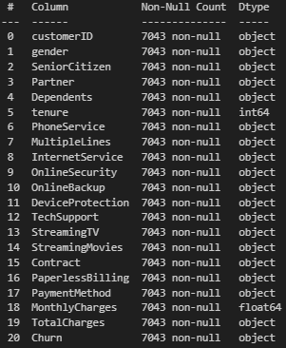
The Data Kingdom – A snapshot
Let’s take a closer look at the key variables in our dataset and how they paint a picture of life in the data kingdom.
Dataset Overview : The dataset contains key features like tenure (how long residents have been in the kingdom), MonthlyCharges (how much they pay for services), and TotalCharges (how much they’ve spent overall), among others
Structure : We have data on approximately 7,000 residents, including demographic information (e.g., gender, age, contract type), and service usage (e.g., TechSupport, StreamingTV, etc).

Slide 4
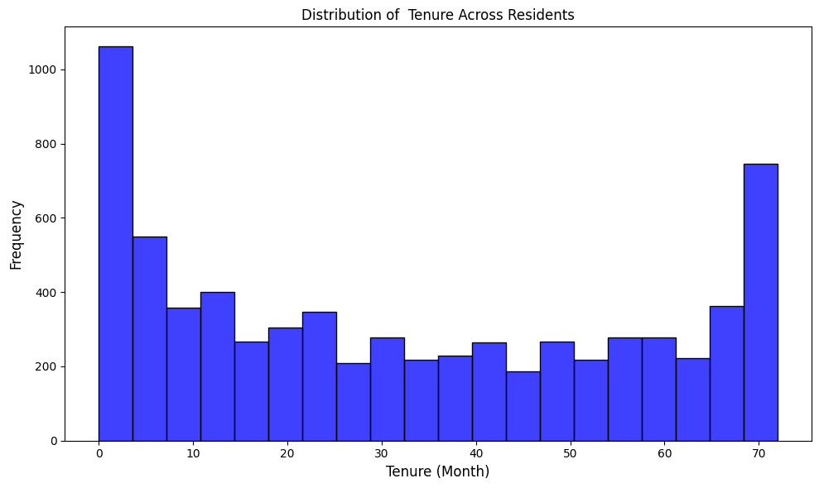
Entering the Data Kingdom – Key Metrics
As Mario begins his journey through the kingdom, he uncovers some important insights into the financial lives of the kingdom’s residents
Insight : The distribution of tenure reveals that the kingdom has a mix of newcomers and long-term loyal residents. However, the majority of residents fall within the first 12 months, indicating a high inflow of new residents but also a potential vulnerability for early-stage churn.
Key Takeaway : Retention strategies should focus on the critical early months of a resident’s journey in the kingdom

Slide 5
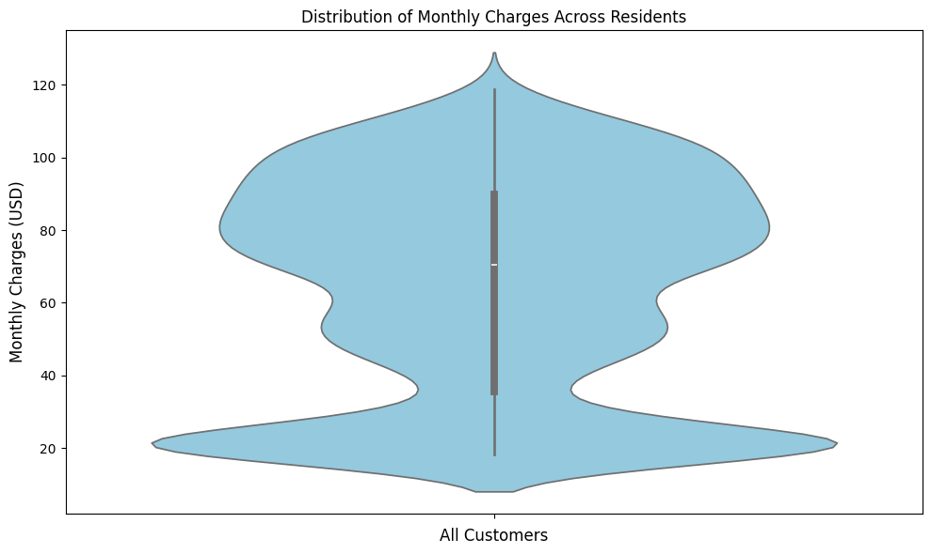
The Financial Landscape – A Diverse Kingdom
Mario also discovered that MonthlyCharges varied greatly, from basic to premium services
Insight : The Violinplot shows that MonthlyCharges are clustered around the mid-range, with a smaller group of residents paying either very low or very high charges. Premium-paying residents constitute a minority but may contribute significantly to revenue
Key Takeaway : To secure the financial health of the kingdom, retention strategies must cater specifically to premium-paying residents, who are at greatest risk of Churn

Slide 6
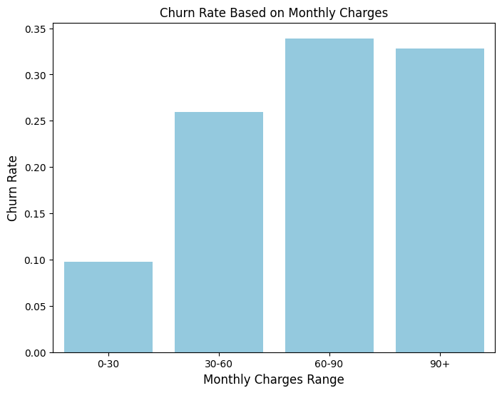
The Churn Rate Discovery
Mario then discovered the alarming churn rate, especially among higher-paying residents
Insight : Analyzing churn across different MonthlyCharges shows that residents in the 60-90 coin range exhibit the highest churn rates. This could indicate dissatisfaction with the perceived value of services in this pricing tier
Key Takeaway : Introducing more value-added services or discounts for mid-to-high-paying residents can help reduce churn in this segment

Slide 7
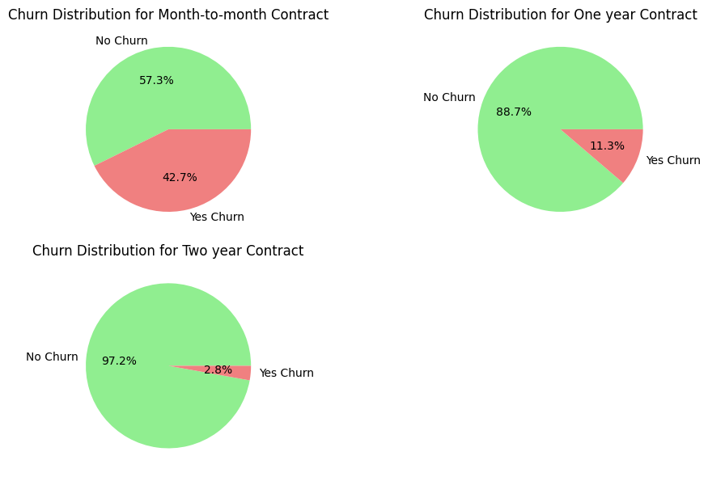
The Contract Realm – Loyalty vs. Flexibility
Insight : Residents with Month-to-Month contracts have the highest churn rates, while those with longer-term contracts (One-Year and Two-Year) are significantly more likely to stay. This indicates that contracts length is a strong predictor of loyalty
Key Takeaways : Encouraging residents to switch from Month-to-Month contracts to longer-term plans through discounts or perks can improve retention

Slide 8
Recommendation for Contracts
Month-to-Month
One-Year Contract
Two-Year Contract
Introduce Retention Programs (Personalized Offers, Loyalty Rewards, Customer Feedback Mechanism)
Enhance Service Quality (Improve service reliability, customer support responsiveness, and perceived value)
Upsell to Longer Contracts (Highlight the cost savings or additional benefits of upgrading to One-Year or Two-Year Contracts
Enhance Value Propositions (introduce mid-contract benefits, offer referral bonuses)
Upgrade Incentives(provide attractive deals for residents to extend their contracts to Two-Year terms before the current one ends)
Regular Management (Use email or app notifications to engage residents with usage stats, personalized tips, or periodic appreciation offers)
Maintain Satisfaction Levels (Regularly assess customer satisfaction to resolve dissatisfaction early)
Reward Long-Term Loyalty (Offer exclusive perks like early access, VIP Customer Support, or Anniversary rewards to reinforce their sense of belonging)
Leverage Advocacy (Turn loyal residents into brand ambassadors by incentivizing referrals or reviews)

Slide 9
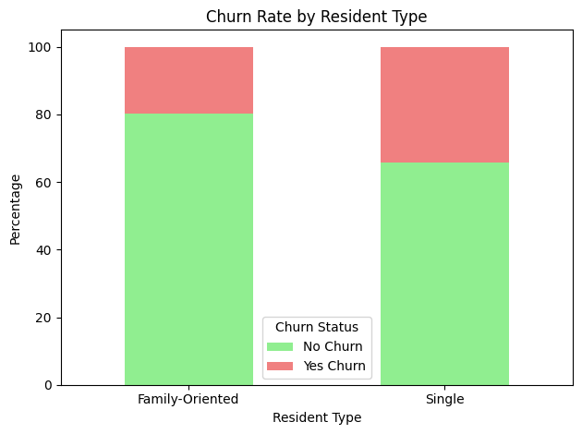
The Single Explorers vs. Family-Oriented Adventurers
Mario observed that Single Explorers had a higher churn rate compared to Family-Oriented Adventurers
Insight : Single residents (Single Explorers) show a high Churn rate compared to families (Family-Oriented Adventurers). This could be due to the higher perceived value of services for families
Key Takeaways : Develop targeted offers for single residents, such as exclusive discounts, flexible plans, or solo-oriented perks

Slide 10
Recommendation for Single Explorers
Tailored Offers and Perks
Proactive Support
Financial Incentives
Design shorter or customizable contract options with minimal penalties, giving Single Explorers the flexibility they value.
Offer service bundles or discounts to reduce financial burdens, making the kingdom more attractive and affordable
Use data analytics to provide offers that align with individual preferences, such as premium add-ons
Implement AI-driven churn prediction models to identify at-risk Single Explorers and offer personalized retention deals before they decide to leave
Provide 24/7 customer service to resolve issues quickly, reducing frustration and increasing satisfaction
Create a gamified loyalty program where single residents earn points or “coins” for long-term contracts, referrals, or consistent usage
Provide discounts or free trials for new customer to entice Single Explorers to stay longer

Slide 11
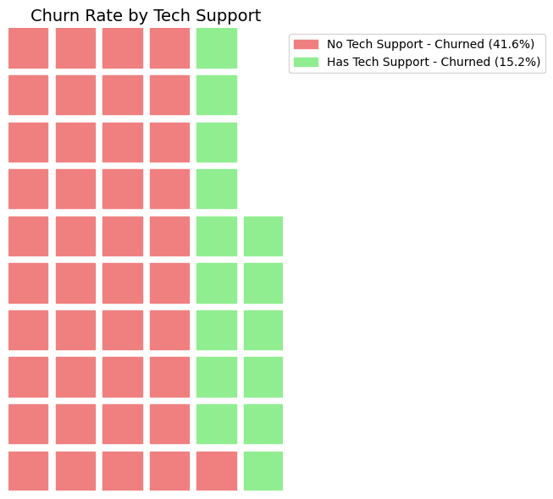
TechSupport – A Game-Changer in Retention
TechSupport plays a pivotal role in reducing churn. Residents with access to TechSupport have a significantly lower churn rate compared to those without, highlighting the importance of customer service. Those with TechSupport feel valued and secure, knowing their issues can be resolved promptly, which builds trust and loyalty.
In Contrast, those without TechSupport often feel frustrated and disconnected, making them more likely to leave. Extending TechSupport universally and addressing customer concerns proactively can significantly reduce churn
TechSupport plays a crucial role in keeping residents from leaving

Slide 12
Recommendation for TechSupport
Automated Assistance
Periodic Satisfaction Check-ins
Community Forums
Promote TechSupport in Marketing
1
Implement AI-driven chatbots for 24/7 basic TechSupport to address minor issues promptly, enhancing customer satisfaction
2
Conduct regular surveys or calls to assess TechSupport effectiveness and identify areas for improvements
3
Create a platform where residents can share tips and solution, fostering a sense of community and reducing dependence on formal support
4
Highlight the availability and quality of TechSupport in marketing materials to attract new residents and assure existing one

Slide 13

Conclusion – The Hero’s Journey Continues
By Addressing the root causes of churn, whether financial, contractual, or service-related. The Data Kingdom can thrive with loyal and satisfied residents.

Slide 14
—Unknown
“In the game of business, the only way to win is to keep your players engaged.”

Slide 15
CONTACT
Do you have any questions?
handwitanto@gmail.com
+62 85691175073
https://github.com/ebhon

